Slide 1
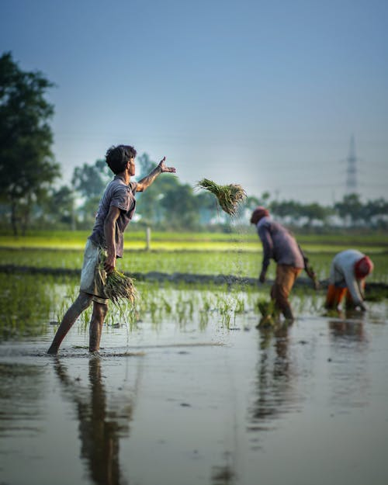
AGRIASSIST
By:
Deepa sri vadla [23911A0514]
Guide:
Ms.G.Surekha

Slide 2
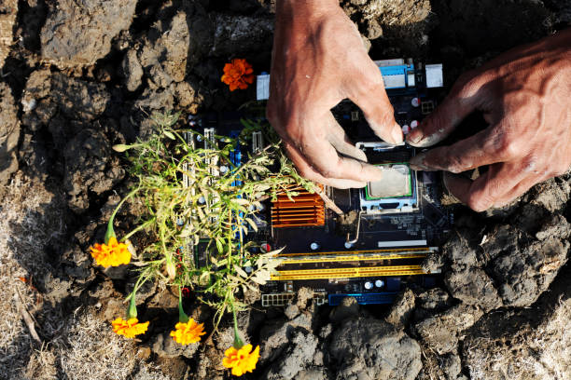
Abstract:
AgriAssist is a web-based application developed to assist farmers by providing essential agricultural insights, improving their decision-making process. The application includes a secure user authentication system to ensure data privacy and personalization. Key features include real-time weather updates, soil analysis for optimized crop selection, market price tracking for various crops, and an AI-powered crop recommendation system. The application supports multiple languages, including English, Hindi, Tamil, Telugu, and Malayalam, making it accessible to a broader audience. With a user-friendly interface and responsive design, AgriAssist ensures seamless navigation and usability. By leveraging AI and cloud computing, the platform enhances agricultural productivity and reduces uncertainties associated with farming decisions.

Slide 3
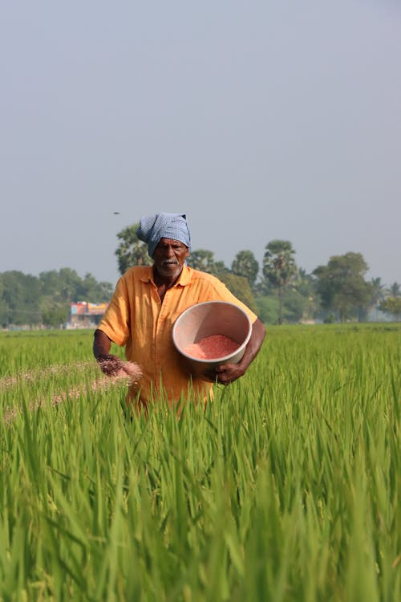
Literature Survey:
Traditional farming methods heavily rely on personal experience rather than data-driven insights, leading to inconsistent yields. Existing agricultural applications primarily focus on weather forecasts or crop prices but often lack integrated soil analysis and AI-driven recommendations. Several research papers emphasize the importance of a unified agricultural platform that combines weather, soil, and market data to enhance decision-making. AgriAssist addresses these challenges by integrating real-time weather data, soil analysis, and AI-based crop recommendations into a single platform, thereby empowering farmers with scientifically backed insights. Furthermore, its multilingual support ensures that farmers across diverse linguistic backgrounds can easily access and understand critical agricultural information.

Slide 4
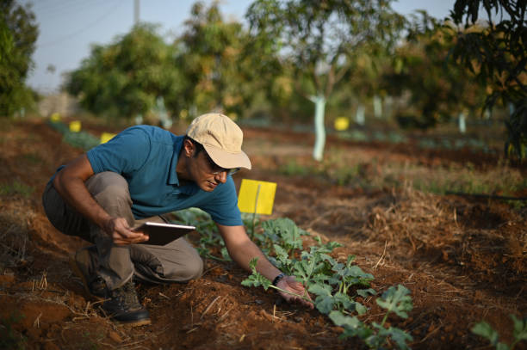
Existing work:
The development of AgriAssist requires a robust technological stack. The frontend is developed using React.js for the web version and Thunkable for mobile applications. The backend utilizes Python with Flask/Django or Node.js to manage authentication, data processing, and AI-driven recommendations. Firebase or MySQL serves as the database for storing user data and historical records. Essential APIs such as OpenWeather API and Soil Data API facilitate real-time data retrieval. The hardware requirements include a system with a minimum of 4GB RAM for development, while end-users require a smartphone or desktop with internet connectivity. Future enhancements may involve integrating IoT sensors for real-time soil moisture and temperature monitoring, further improving agricultural decision-making.

Slide 5
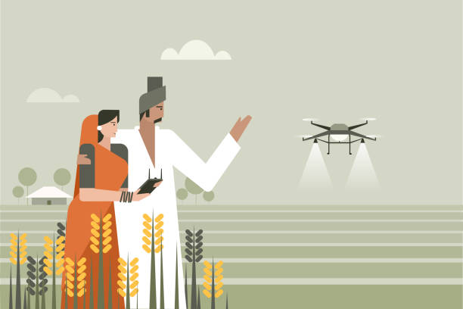
Proposed work:
AgriAssist aims to transform traditional farming methods by providing farmers with real-time, data-driven insights. The project’s scope includes delivering accurate weather forecasts, soil analysis, and crop recommendations while reducing dependency on intermediaries by offering direct access to market price trends. The primary objectives of AgriAssist are to develop an interactive web and mobile platform, integrate AI for precise agricultural analysis, ensure multilingual accessibility, and facilitate efficient farm management through digital record-keeping. By achieving these goals, AgriAssist seeks to optimize farming practices, increase productivity, and empower farmers with innovative agricultural solutions.

Slide 6
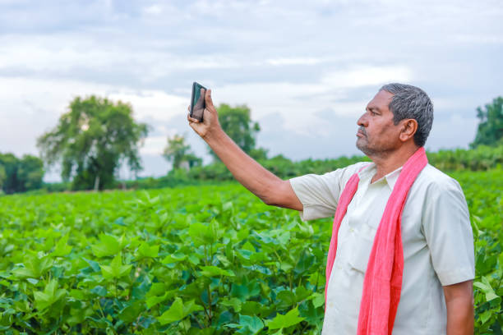
Objective:
Develop a web and mobile application for farmers.
Integrate AI to analyze soil, weather, and crop data.
Provide a multilingual interface for easy accessibility.
Enable seamless farm management with digital record-keeping.

Slide 7
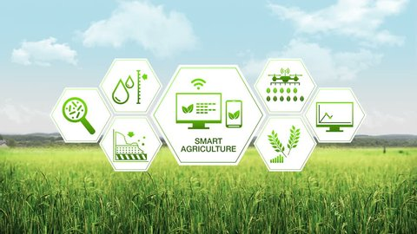
LIST OF MODULES:
*Client-Server Model:* The app and website interact with a cloud-based backend for data processing.
Data Flow:
1. User inputs location and soil details.
2. System fetches weather and soil data using APIs.
3. AI processes data to recommend best-suited crops.
4. Market module updates prices and trends for farmers.

Slide 8
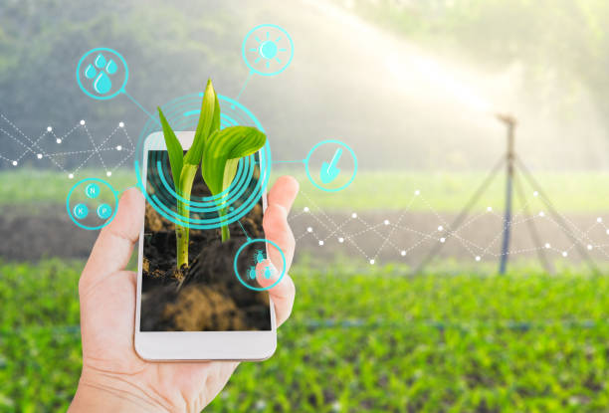
TECHNOLOGIES USED:
FRONTEND:
React.js (Website) - Thunkable (Mobile App)
BACKEND:
Python (Flask/Django) or Node.js
DATABASE:
Firebase / MySQL
APIS & EXTERNAL SERVICES:
OpenWeather API (for real-time weather data) - Soil Data API (for soil analysis) - Google Translate API (for multilingual support)
AI/ML INTEGRATION:
Machine Learning for crop prediction - Data analytics for soil and weather trend analysis

Slide 9
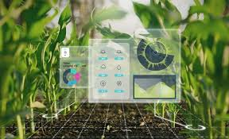
CONCLUSION:
AgriAssist is a smart, data-driven agricultural platform that helps farmers make informed decisions about crop selection, soil health, and market trends. By integrating AI, IoT, and cloud technologies, it aims to increase farm productivity and reduce losses.
FUTURE ENHANCEMENTS:
AI-based pest detection and disease prediction.
lockchain integration for supply chain transparency.
Voice assistant feature for better accessibility.

Slide 10
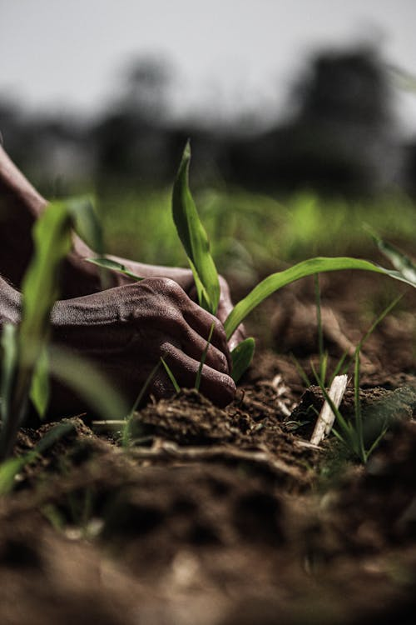
REFERENCES:
- Research papers on precision farming and AI in agriculture.
- Government reports on agricultural challenges and solutions.
- API Documentation: OpenWeather, Soil Data API, Firebase.
- Articles on market trends in agriculture technology.

